Slide 1


Welcome to Aviation Skillnet

Slide 2

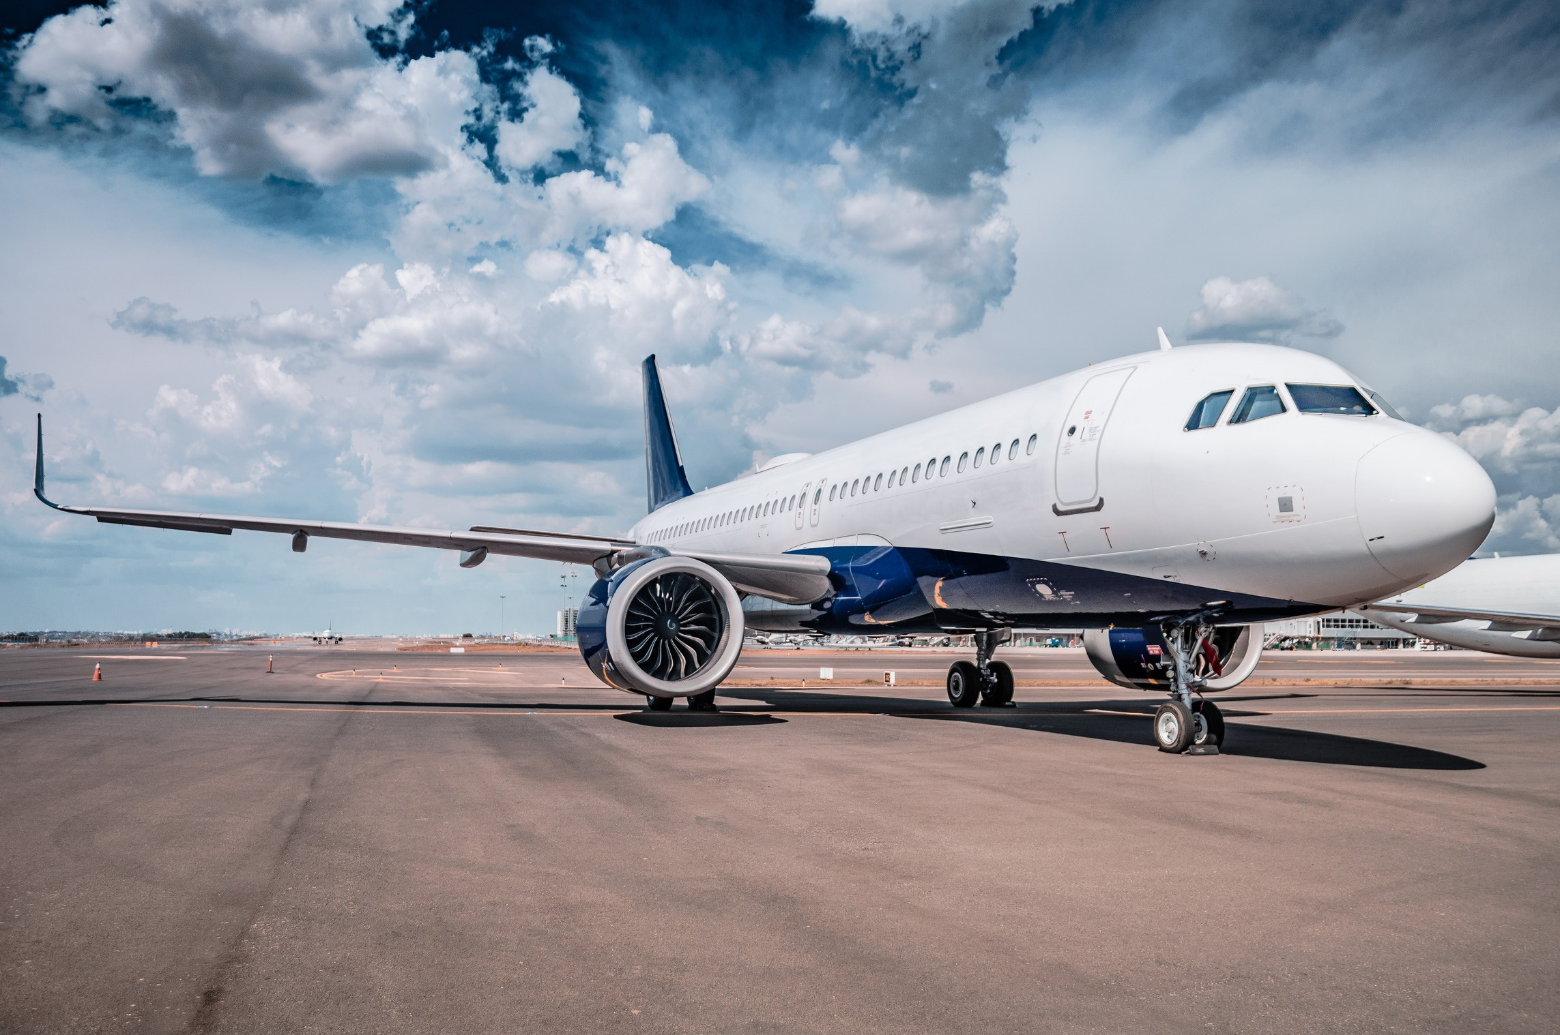

Aviation Update 2021- Presents
Ulick McEvaddy
Co-founder of Omega Air lnc

Slide 3
Introduction
Session overview
PART 1
Geopolitical forces affecting Aviation industry
PART 2
PART 3
The rise of China in the Aviation Sector
PART 4
The rise of Aviation in India/Asia Pacific
PART 5
Next Steps towards a carbon neutral future
02

Slide 4



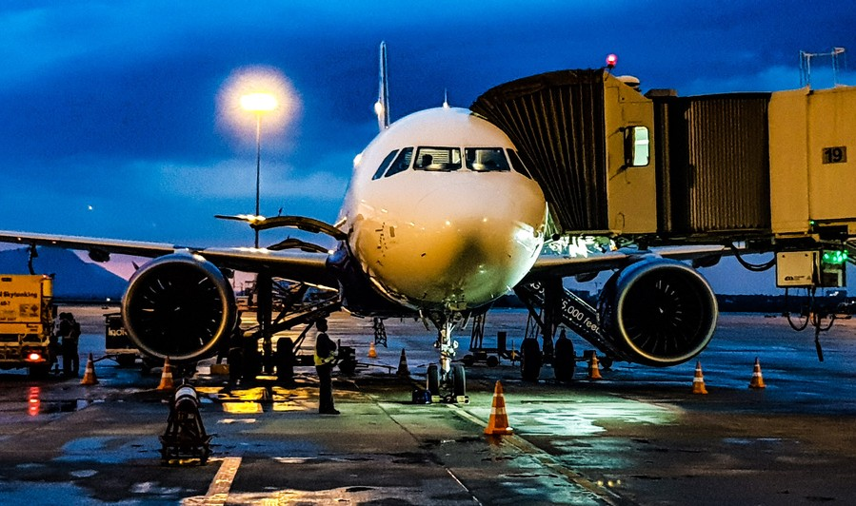

Introduction
Airlines are likely to emerge from the crisis as much smaller organizations with more streamlined fleets as they adjust capacity to demand.
Airlines have received remarkable levels of government support globally in a region of $170b which have come in the form of loans guarantees, wage subsidies, tax deferrals and equity injections. It is about survival and every dollar is welcome.
This level of gov support shows how fundamentally important air transport is to the global economy.

Slide 5
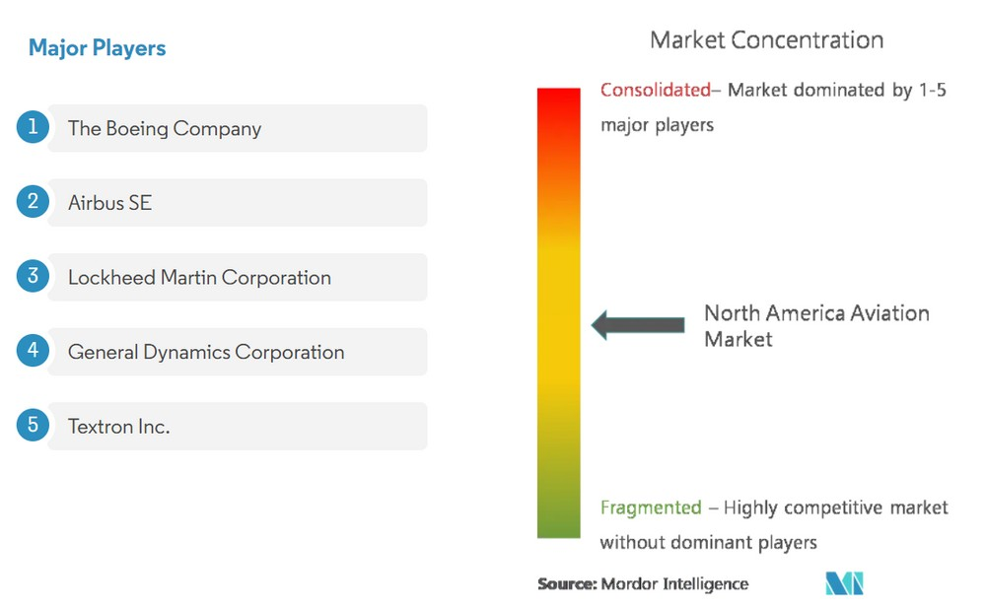
The USA Aviation Industry
The United States, as of Q1 2021, was facing huge challenges due to the COVID-19 pandemic across all sectors. According to IATA, North American airlines’ full-year passenger traffic fell 75.4% compared to 2019, making it the third-largest region after Asia-Pacific and Europe, in terms of passenger traffic.
The aviation industry in North America is matured and has the presence of several aircraft OEMs. The defence sector has benefitted mainly due to this fact, owing to the growing government investment in R&D and the procurement of advanced fighter jets, helicopters, transport, and trainer aircraft from the regional players.
The demand for air cargo increased in the United States in 2020. Correspondingly, the air cargo carriers in the country have ordered new aircraft to expand their fleet. In January 2021, DHL Express increased the number of 777F's it had on firm order with Boeing.

Slide 6

Australia's Aviation Industry
While responding to the immediate COVID-19 crisis, the Australian Government is also looking ahead, to ensure the aviation sector is on a sustainable long term footing once travel bans and border restrictions are lifted. This is a challenging task, which requires the expertise and input of the sector and those that rely on it. The government is seeking public input to inform on a Five-Year Plan, to strengthen and grow the Australian aviation sector beyond COVID-19.
The restoration of confidence will be at the core of the recovery of the aviation sector and the economy more broadly
OBJECTIVES
Preserve critical capacity so a competitive aviation market can restart as the economy emerges from COVID-19 and COVID restrictions are lifted
COVID 19 RESPONSE
Reducing the regulatory burden Greater local decision making Targeted assistance
5 YEAR PLAN

Slide 7
Middle East Aviation Industry
The Middle-East Aviation Market was valued at USD 13.19 billion in 2020 and is projected to reach USD 23.07 billion in 2026 with a growth rate of 7.86% during the forecast period (2021-2026). In the Middle-Eastern aviation market, Saudi Arabia currently
PAST SCENARIO & GROWTH
CURRENT SCENARIO
FUTURE OF MIDDLE EAST
the passenger traffic growth decreased in 2019 compared to 2018 and the advent of the COVID-19 pandemic has further slashed the passenger traffic in 2020.
The presence of a large number of high-net- worth individuals in the region has resulted in a higher preference for business jet and helicopter travel during the pandemic.
The advent of new budget carriers like Air Arabia Abu Dhabi and Wizz Air Abu Dhabi is expected to propel the demand for new narrow- body aircraft in the years to come.
accounts for a major market share. The country is undergoing a progressive change to become a key aviation-related industry in the region and is witnessing an increase in the
number of developments related to the market.

Slide 8
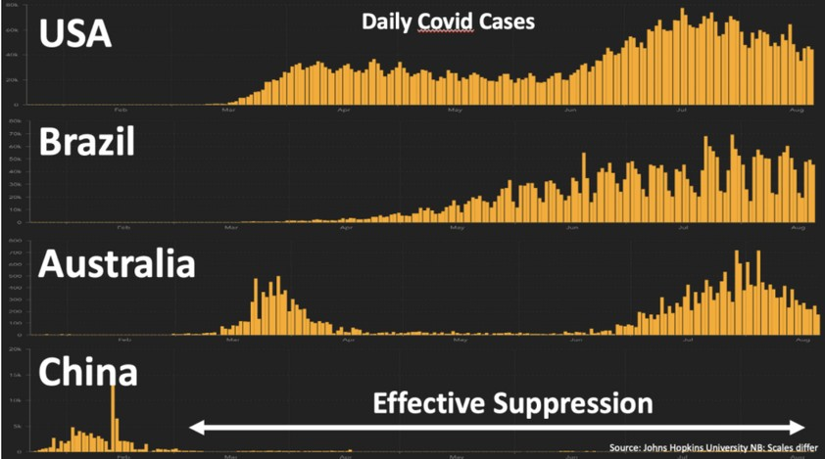
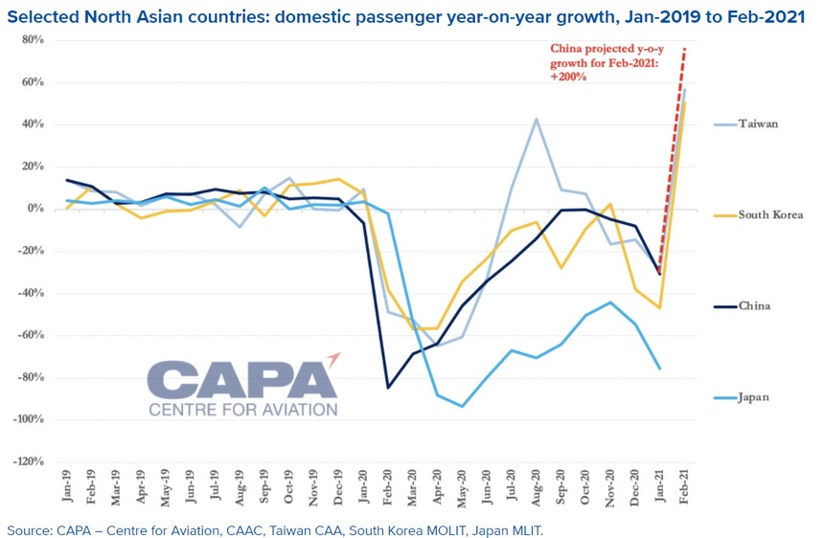
The rise of China in aviation Sector
Massive rates of COVID PCR testing and quarantines for Chinese travelers who have visited a high-risk region in the prior 14 days have been crucial to maintaining China’s low rates of infection.
Chinese airlines expected to remain in the red in 1Q2021, due to the missed opportunity during the Lunar New Year, when citizens were strongly encouraged to stay put.
China previously considered easing border restrictions if it could achieve its aim of vaccinating at least 70% of its population by the Northern Spring of 2021.
With this and an array of other factors in mind, CAPA’s exclusive Air Capacity Model projects China’s international market to remain largely closed in 2021.
Chinese airlines and the country's economy will lead the recovery of the aviation sector from the impact of the Covid-19 pandemic, the International Air Transport Association (IATA) said in November 2020 in its revised outlook for 2020 and 2021.

Slide 9
The rise of aviation in India/Asia Pacific
India is still on track to become the 3rd largest aviation market, despite Covid. It is expected that the growth of freight traffic will be encouraged by the forecasted boost in import and export in India, since 30% of the Indian trade total is transported by aircraft
COVID 19 IMPACT
The India Brand Equity Foundation (IBEF) estimated that the COVID- 19 pandemic would have a longer- lasting impact on international air travel than on domestic operations across India.
CURRENT RANKS
Currently, India is the seventh-largest civil aviation market in the world and the third-largest aviation market in terms of domestic operations.
FUTURE PREDICTION
In the National Air Cargo Policy Outline, the
government of India predicts that the Indian air cargo and logistics have a significant potential to become the most cost efficient and time-effective globally by the end of 2030.

Slide 10

European Green Deal
Climate action is at the heart of the European Green Deal- an ambitious package of measures ranging from ambitiously cutting greenhouse gas emissions, to investing in cutting-edge research and innovation to preserving Europe's natural environment.
First climate action initiatives under the Green Deal include:
European Climate Law to enshrine the 2050 climate-neutrality objective into EU law. European Climate Pact to engage citizens and all parts of society in climate action.
2030 Climate Target Plan to further reduce net greenhouse gas emissions by at least 55% by 2030.
New EU strategy on climate adaptation to make Europe a climate-resilient society by 2050, fully adapted to the unavoidable impacts of climate change.
Global aviation emissions p act:
Fly more efficient aircraft.
Use new technologies to set more efficient flight paths and reduce delays. Use sustainable lower-carbon alternative fuels
Invest in emissions offsets within or outside of the aviation sector.

Slide 11
THANK YOU FOR ATTENDING THE WEBINAR

