Slide 1
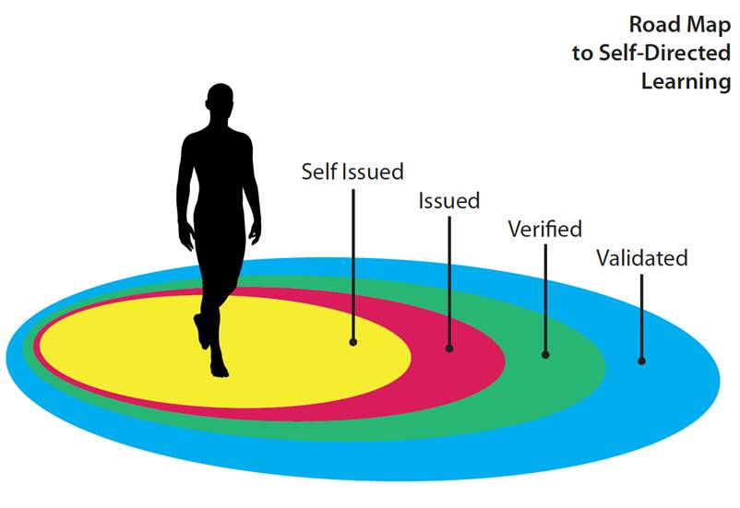
2020 Skillnet Ireland funded Feasibility Study to Consider the Development of a Framework for the Recognition of Micro-Credentials in Industry
Making Learning Visible –
(Phase 1)

Slide 4
OUTPUTS
July 14th Webinar -- Certifying Your Future: Making Sense of Micro-Credentials
July 2020 -- first National Survey of Perspectives of Employees and Employers on Micro-Credentials
August 18th Webinar -- Global Voices on Micro-Credentials: What’s next for industry in Ireland?
August 2020 -- Publication of Insights Paper Micro-Credentials: An Evolving Eco System
March 23rd Webinar – Launch of Final Report
March 2021 – Publication of Final Report A Micro-Credential Roadmap: Currency, Cohesion & Consistency

Slide 9
This research received additional funding from Skillnet Ireland in 2021
Research Report is due in early 2022
Feasibility Study – Phase 2
How can micro-credentials recognise
professional competencies
in a regulated environment?
In partnership with Mazars

